Slide 1
Chapter 6. Firewall – IDS/IPS

Slide 2
Outline
What is an intrusion?
Port security
DHCP snooping
What are firewalls?
Types of Firewalls
IDS/IPS

Slide 3
What is an intrusion?
Intrusion can be defined as any set of actions that attempt to compromise the integrity, confidentiality or availability of resource.
In the context of info systems, intrusion refers to any unauthorized access, unauthorized attempt to access or damage or malicious use of info resources.

Slide 4
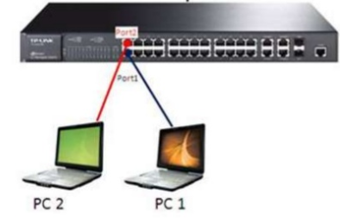
Port Security
Secured ports restrict a port to a user-defined group of stations.

Slide 5
Port Security
Interface :Port to secure.
Security :Enable port security on the port.
Trap :Issue a trap when an address-security violation occurs.
Shutdown Port :Disable the port when an address-security violation occurs.

Slide 6
Port Security
Commands:
SW(config)#interface Fa0/1
SW(config-if)#switchport mode access
SW(config-if)#switchport port-security
SW(config-if)#switchport port-security maximum 1
SW(config-if)#switchport port-security mac-address H.H.H | Sticky
SW(config-if)#switchport port-security violation shutdown
SW(config)#errdisable detect cause all
SW(config)#errdisable recovery cause all
SW(config)#errdisable recovery interval 30

Slide 7
Lab: Port Security

Slide 8
DHCP Snooping
To prevent a Man-in-the-middle attack on our network
Fake DHCP Servers can respond to DHCPDISCOVER messages before the real server has time to respond.
DHCP Snooping allows switches on the network to trust the port a DHCP server is connected to (this could be a trunk) and not trust the other ports.

Slide 9
DHCP Snooping
Commands:
SW(config)#ip dhcp snooping
SW(config)#ip dhcp snooping vlan 1
SW(config)#interface Fa0/1 → connect to real DHCP server
SW(config-if)#ip dhcp snooping trust
SW(config-if)#ip dhcp snooping limit rate 25
Verify the configuration:
SW#show ip dhcp snooping

Slide 10
Firewalls
A part of computer system or network designed to stop unauthorized traffic flowing from one network to another.
Separate trusted and untrusted components of a network.
Differentiate networks within a trusted network.
Main functionalities are filtering data, redirecting traffic and protecting against network attacks.

Slide 11
Requirements of a firewall
All the traffic between trust zones should pass through firewall.
Only authorized traffic, as defined by the security policy, should be allowed to pass through.
The firewall itself must be immune to penetration, which implies using a hardened system with secured Operating Systems.

Slide 12
Firewall Policy
User control: Controls access to the data based on the role of the user who is attempting to access it. Applied to users inside the firewall perimeter.
Service control: Controls access by the type of service offered by the host. Applied on the basis of network address, protocol of connection and port numbers.
Direction control: Determines the direction in which requests may be initiated and are allowed to flow through the firewall. It tells whether the traffic is “inbound” (From the network to firewall) or vice-versa “outbound”

Slide 13
Firewall actions
Accepted: Allowed to enter the connected network/host through the firewall.
Denied: Not permitted to enter the other side of firewall.
Rejected: Similar to “Denied”, but tells the source about this decision through ICMP packet.
Ingress filtering: Inspects the incoming traffic to safeguard an internal network and prevent attacks from outside.
Egress filtering: Inspects the outgoing network traffic and prevent the users in the internal network to reach out to the outside network. For example like blocking social networking sites in school

Slide 14
Types of filters
Depending on the mode of operation, there are three types of firewalls :
Packet Filter Firewall
Stateful Firewall
Application/Proxy Firewall

Slide 15
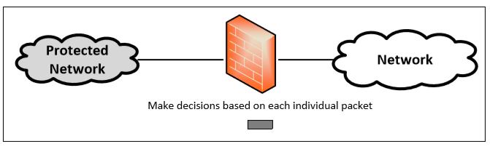
Packet Filter Firewall
Controls traffic based on the information in packet headers, without looking into the payload that contains application data.
Doesn’t pay attention to if the packet is a part of existing stream or traffic.
Doesn’t maintain the states about packets. Also called Stateless Firewall.

Slide 16
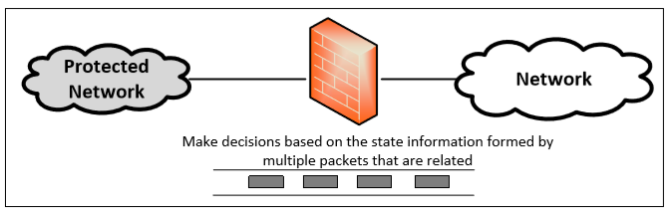
Stateful Firewall
Tracks the state of traffic by monitoring all the connection interactions until is closed.
Connection state table is maintained to understand the context of packets.
Example : Connections are only allowed through the ports that hold open connections.

Slide 17
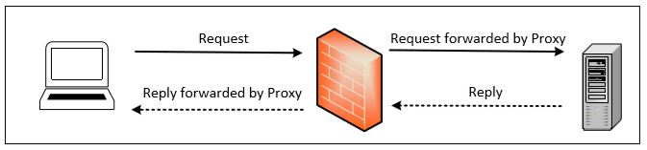
Application/Proxy Firewall
Controls input, output and access from/to an application or service.
Acts an intermediary by impersonating the intended recipient.
The client’s connection terminates at the proxy and a separate connection is initiated from the proxy to the destination host.
Data on the connection is analyzed up to the application layer to determine if the packet should be allowed or rejected.
Notes:
Limitation : Need to implement new proxies to handle new protocols. Slower compared to other firewalls
Advantage : Ability to authenticate users directly rather than depending on network addresses of the system. Reduces the risk of IP spoofing attacks that are easy to launch against a network.

Slide 18
IDS – Intrusion Detection System
The main function of an IDS is to warn about suspicious activity taking place, but not to prevent them
An IDS specifically looks for suspicious activity and events that might be the result of a virus, worm or hacker

Slide 19
IDS – Intrusion Detection System
All IDS have three things in commons:
Sensors: collect traffic and user activity data and sends to analyzer
Analyzer: looks for suspicious activity
Administrator interface: If analyzer detects suspicious activity, sends an alert to the Admin interface.

Slide 20
IDS – Intrusion Detection System
Types of IDS
NIDS
- Use sensors to monitor all network traffic
- Cannot see the activities within the computer itself
HIDS
- Install on workstations/Servers
- Watches for abnormal activity

Slide 21
IDS – Intrusion Detection System
Signature based
Pattern matching
Stateful matching
Anomaly based
Statistical anomaly based
Protocol anomaly based
Traffic anomaly based
Rule based

Slide 22
IPS – Intrusion Prevention System
IPS is any device (hardware or software) that has the ability to detect attacks, both known and unknown, and prevent the attack from being successful
Classification of IPS
- HIPS
- NIPS

Slide 23
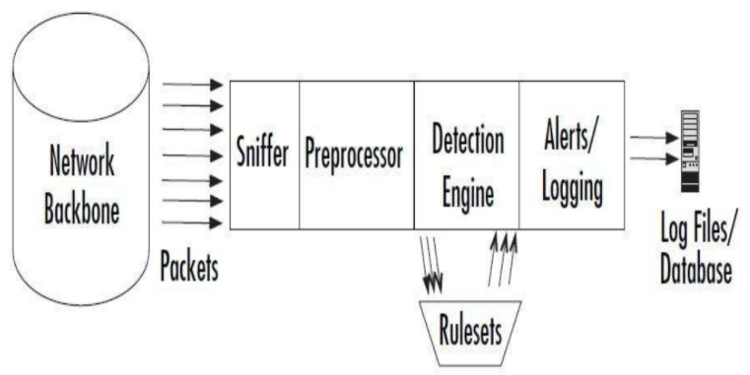
Lab : Snort IDS
There are four basic components of Snort’s architecture:
The Sniffer
The Preprocessor
The Detection Engine
The Output

